Slide 1
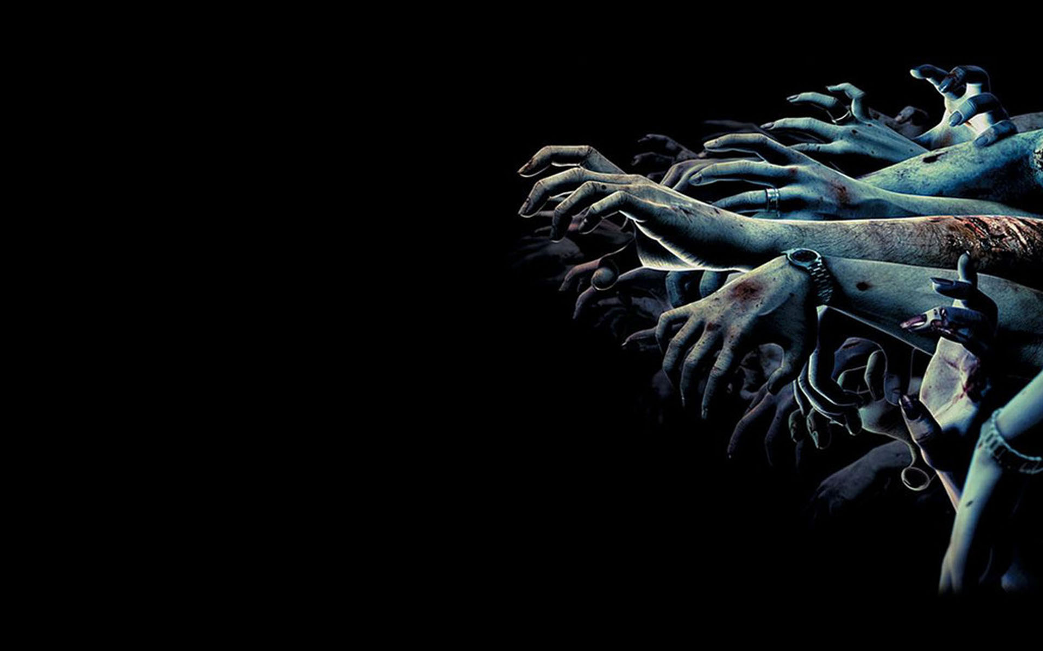

Slide 2


Slide 3
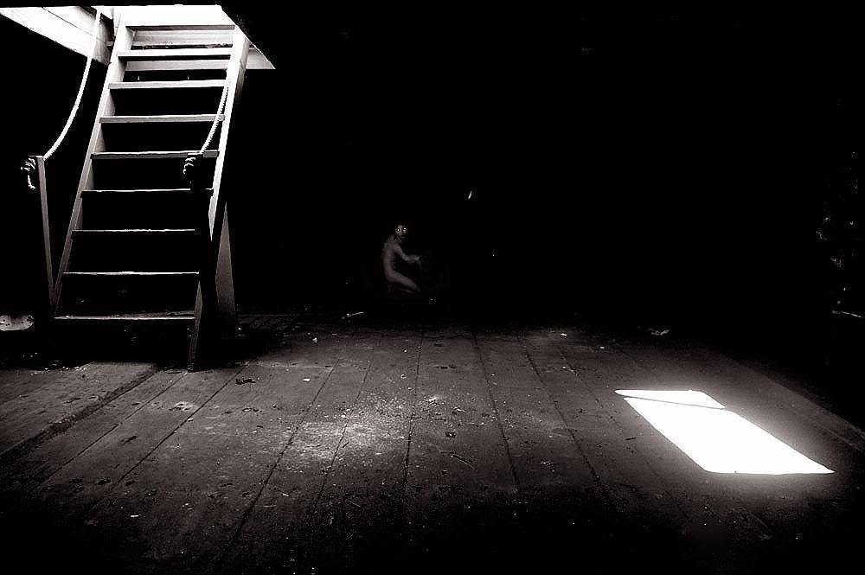
Background

Slide 4
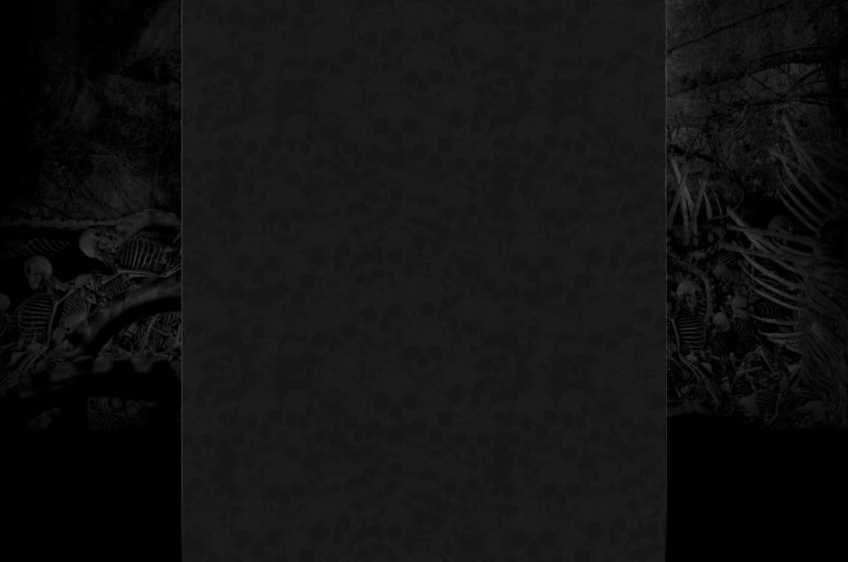


IDEA
Resident Evil

Slide 5
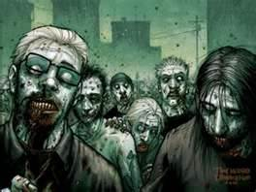
Story of Last Survivor
Location
A genetic research facility
Character
Four uninfected researchers, two spies, one agent and one infected researcher
Situation
A researcher stool and injected a virus in his body. Also, he contaminated the facility with the virus.

Slide 6

In order to avoid the virus leaked out from the facility, the government sent an agent inside the facility to kill all the survivors except the spies. The spies were sent by the government to help the agents to finish the mission.

Slide 7
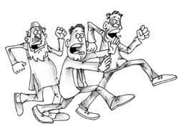


The facility was sealed by the government. So, the only way for the researchers to escape from the facility was to kill the agent and took the key to open the door of the facility.

Slide 8
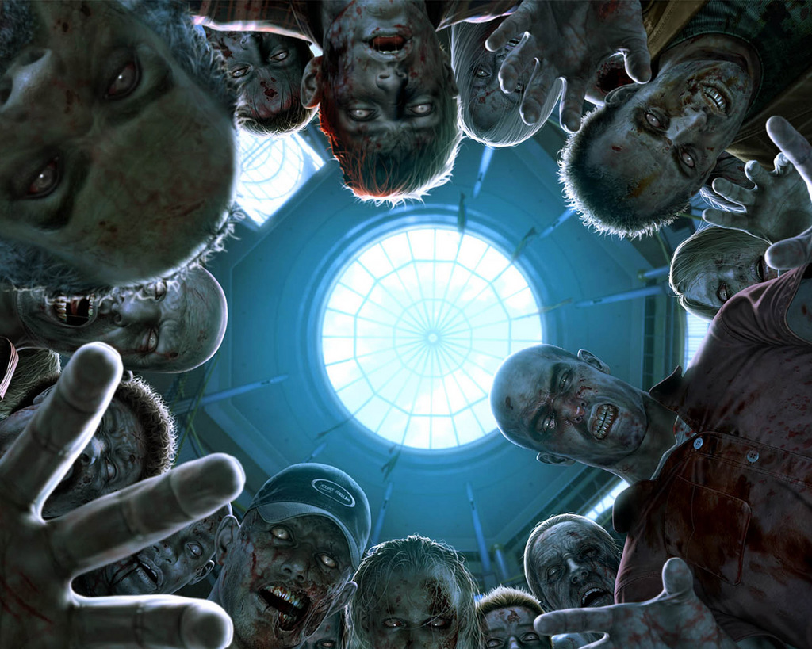
For the infected researcher, he knew that both the agent and the uninfected researchers would try to kill him if they found that he stole the virus. So, the only way for him to survive was to kill all the others and took the key in order to escape from the facility.

Slide 9

Objective
Agent and Spies → Kill all the infected and uninfected researchers
Uninfected researchers → Kill the agent
Infected researches → Kill all the people in a proper order, the agent should be the final one to be killed

Slide 10
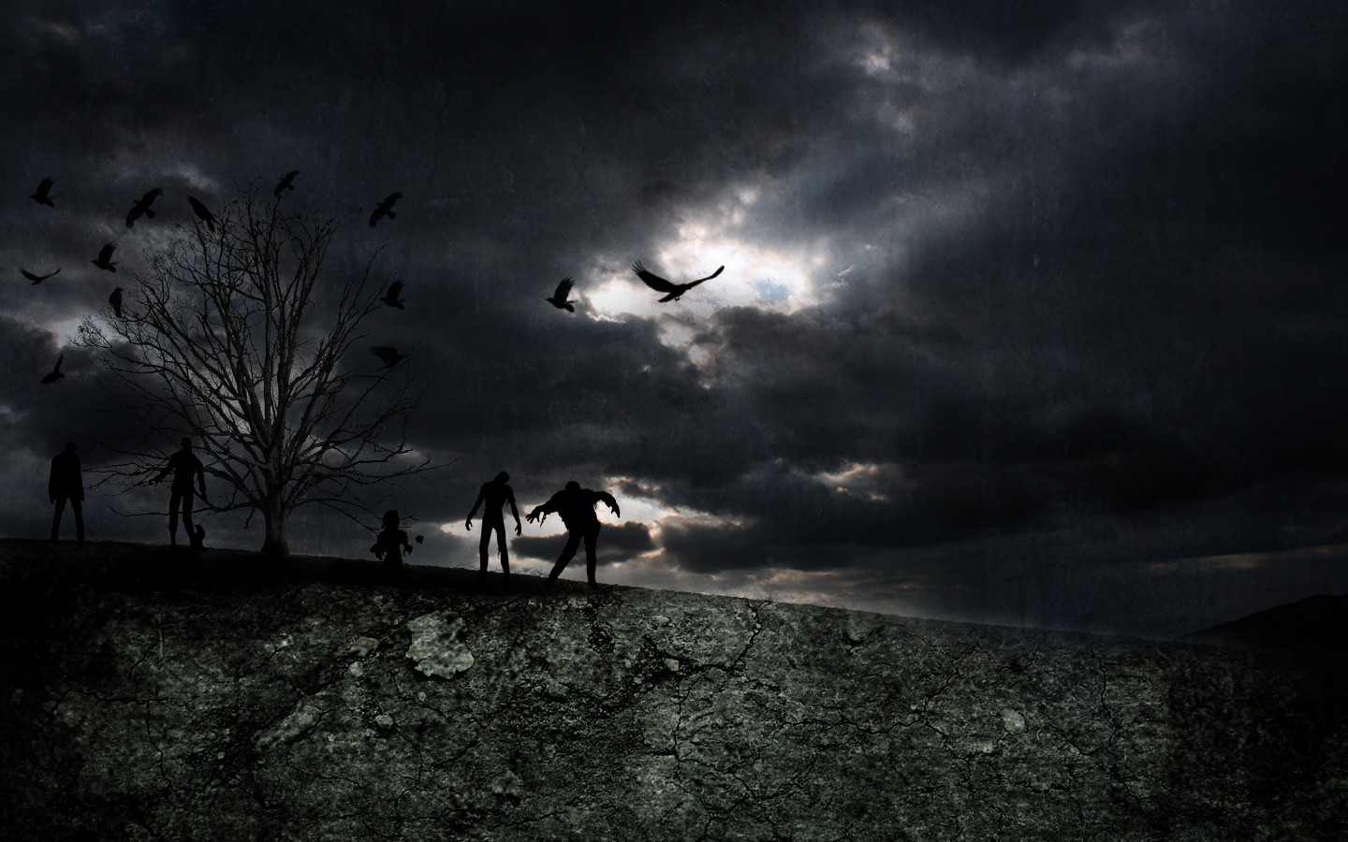
New Elements

Slide 11
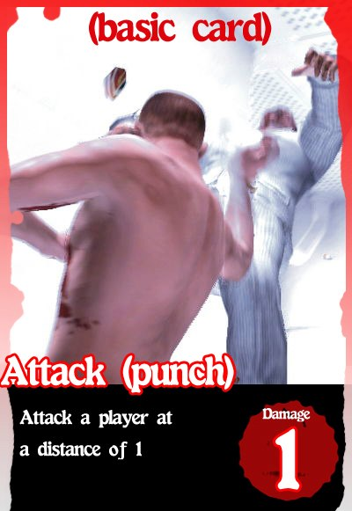
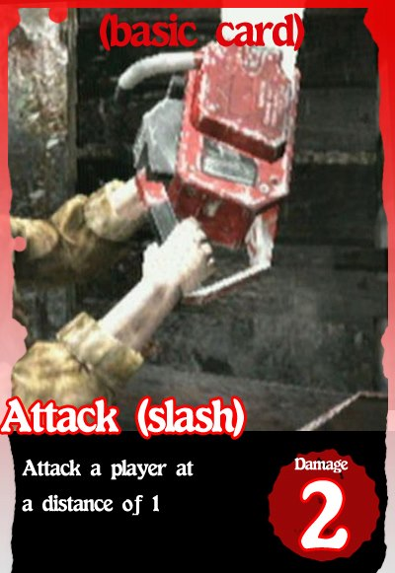
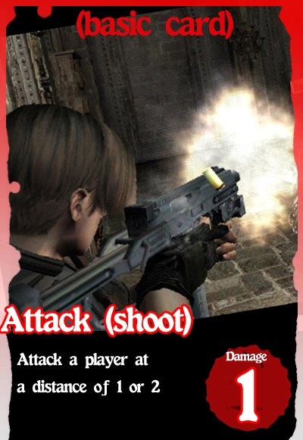
New type of Attack
More method to reduce other player’s life point
Three modes of attack with different distance and damage

Slide 12
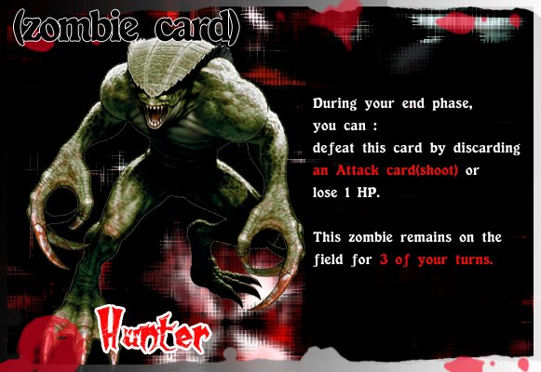
Zombie card:
Damage over time if player fail to discard an attack! Card.

Slide 13
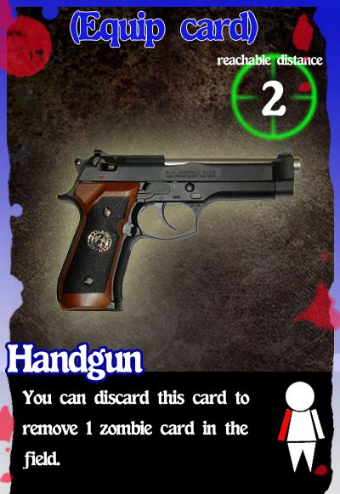
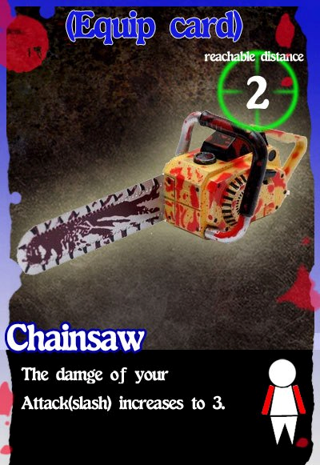
New permanent cards
Allow players armed to the teeth by :
Adding new type of weapon
with special effect
(one-handed and two handed weapon)

Slide 14
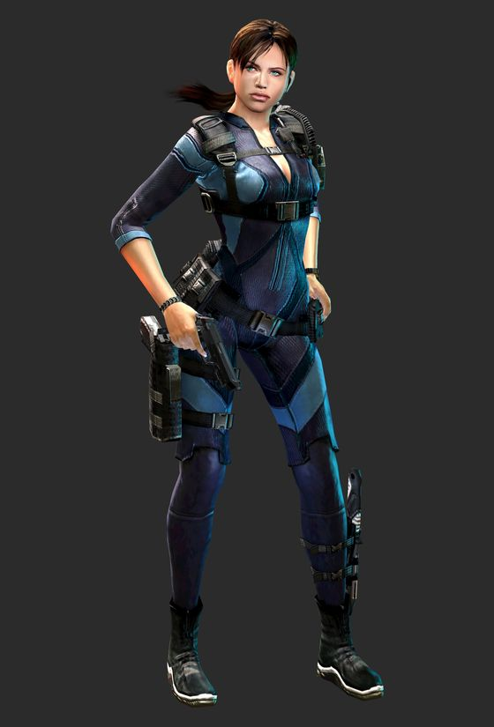
Creating plenty of armor
Players can equip 3 of them on the slot of head, upper and lower body
Equip yourself!!

Slide 15
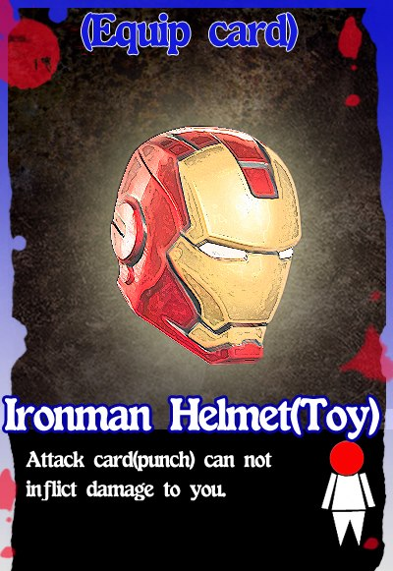
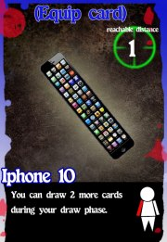
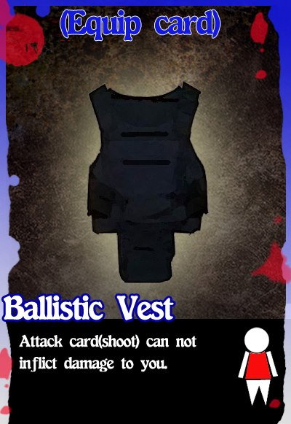
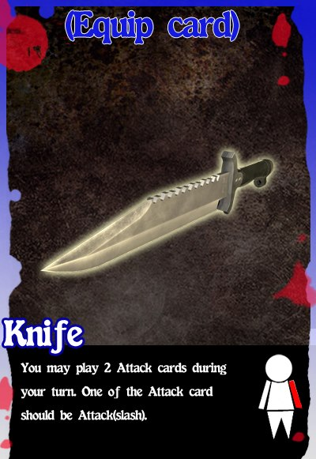
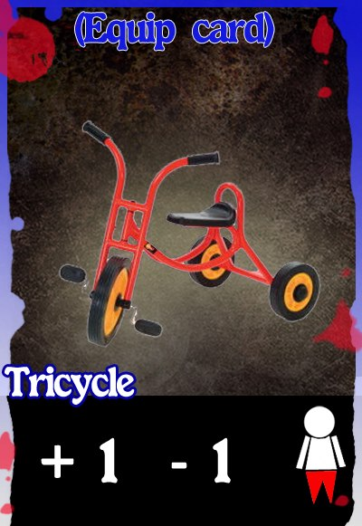
MAIN HAND
HEAD GEAR
OFF HAND
UPPER GARMENT
LOWER GARMENT

Slide 16
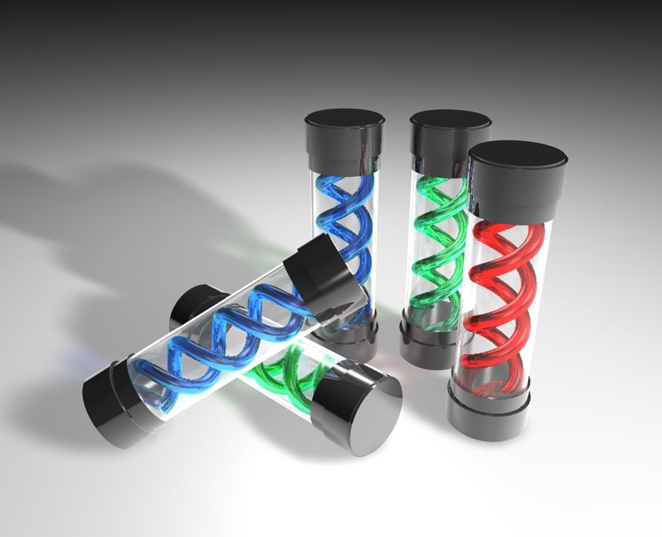
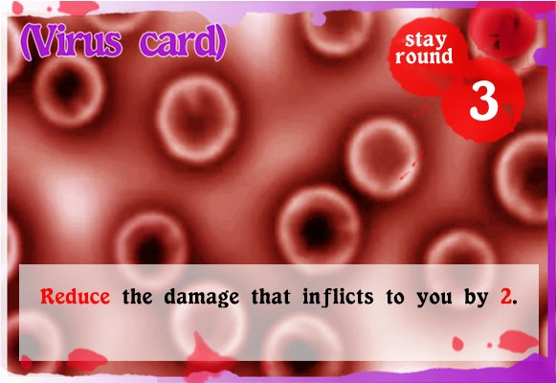
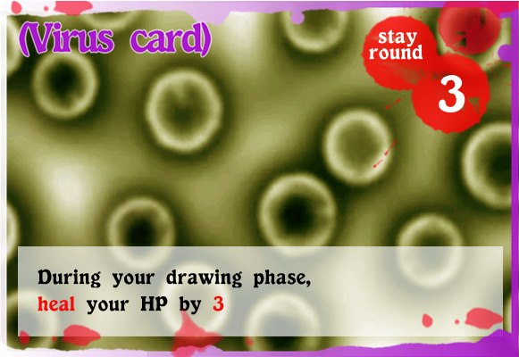
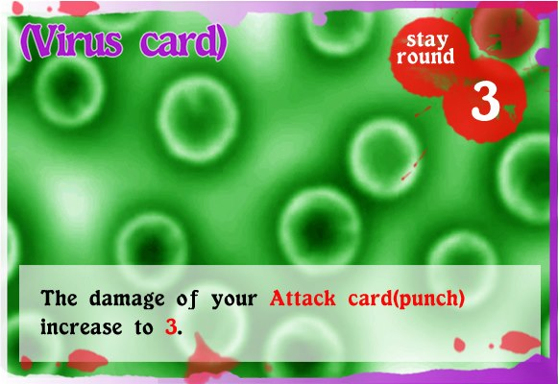

Virus card
A powerful buff(increase abilities)
Only last temporarily

Slide 17
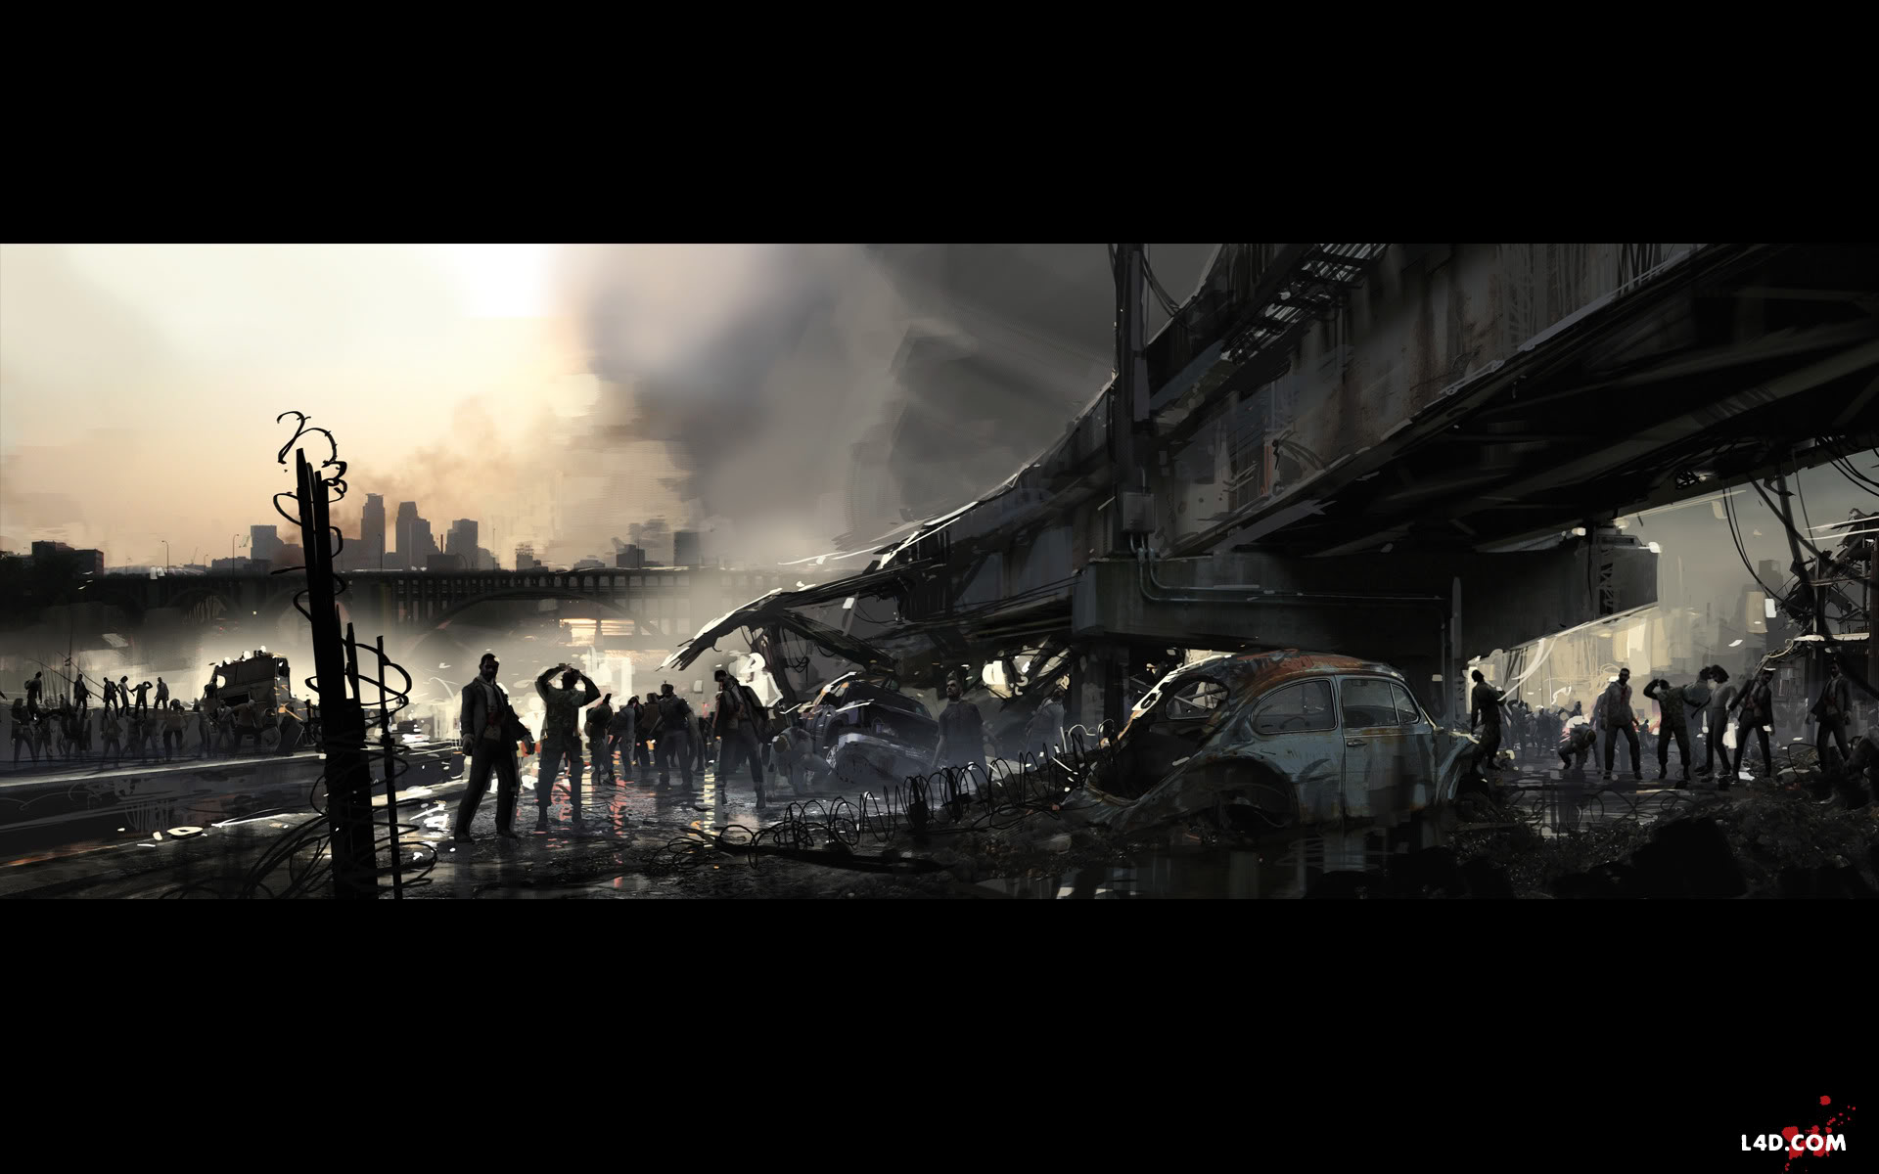
Characters

Slide 18
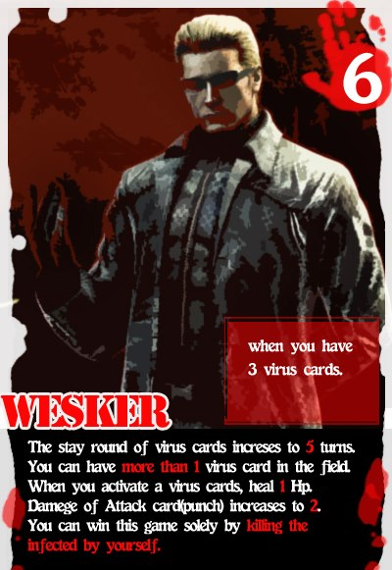
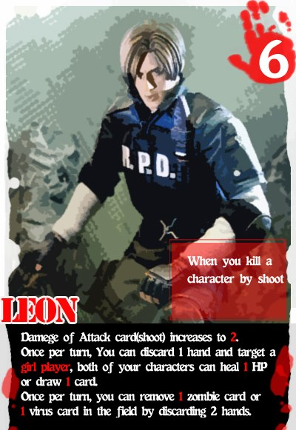
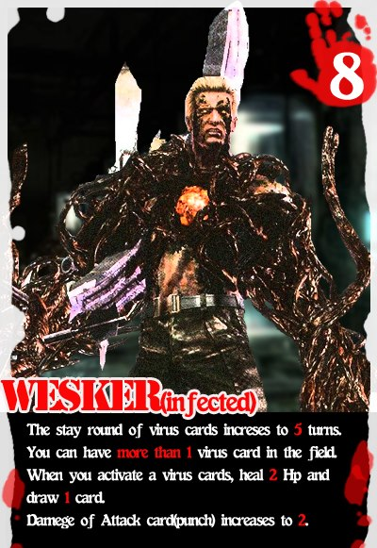
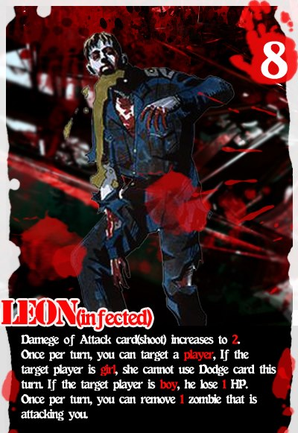

Slide 19
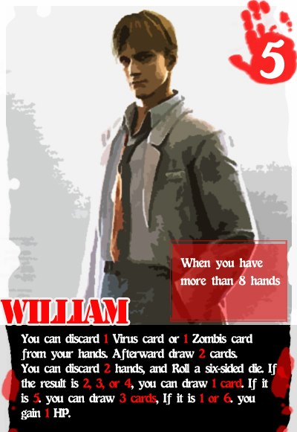
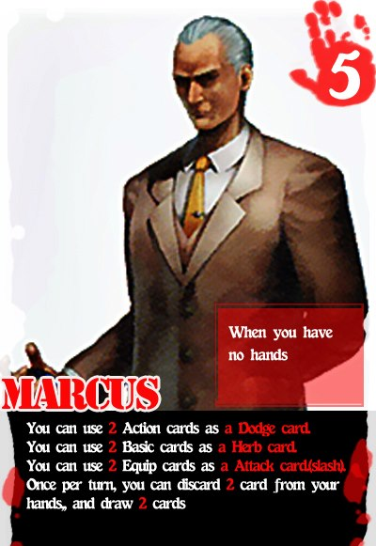
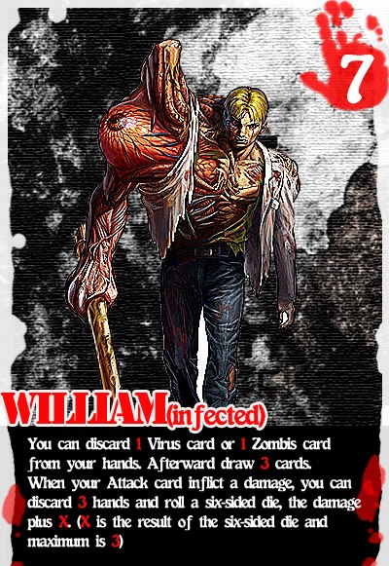
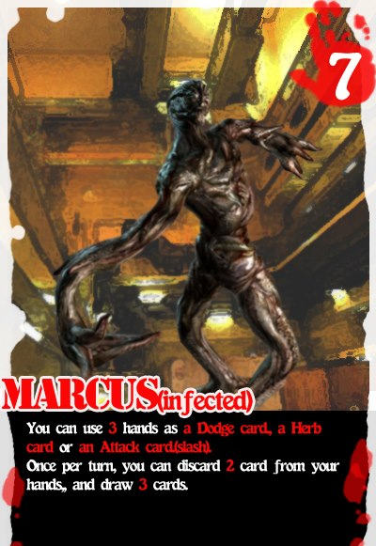

Slide 20
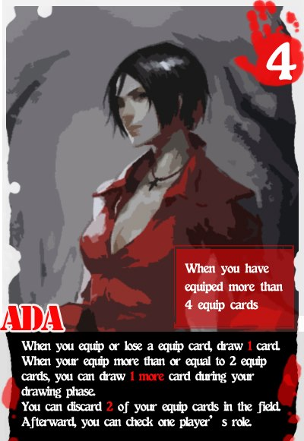
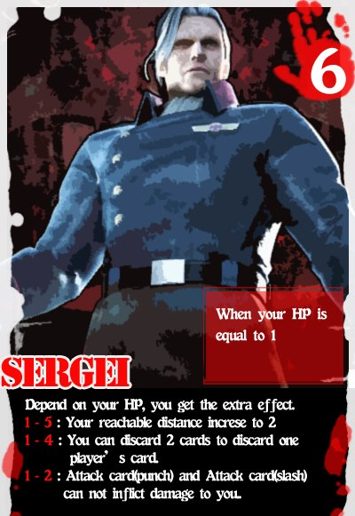
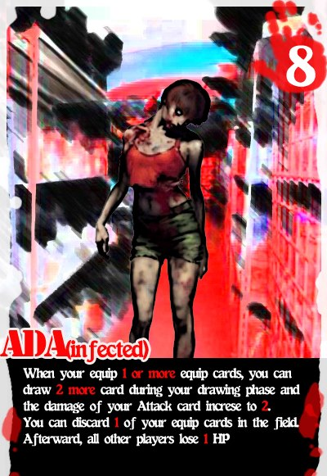
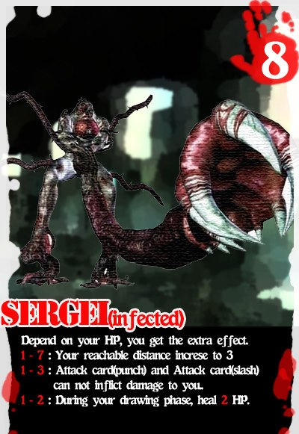

Slide 21
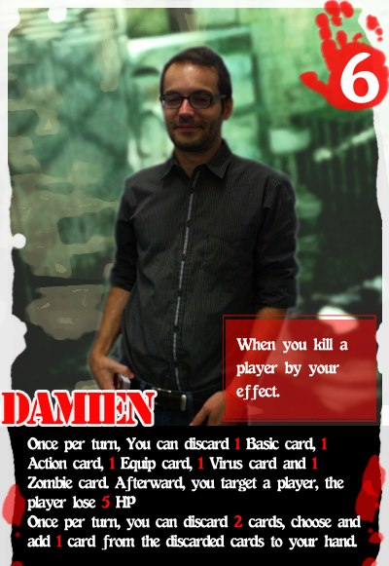
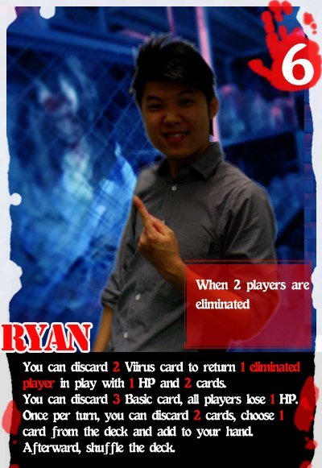
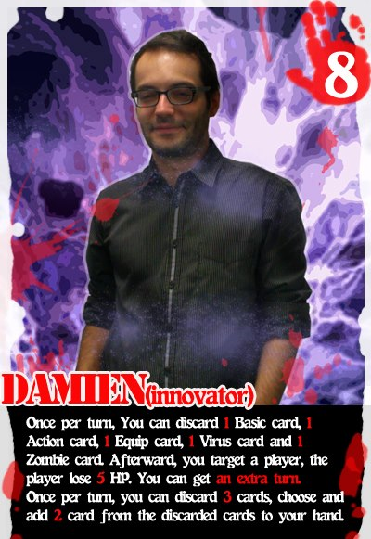
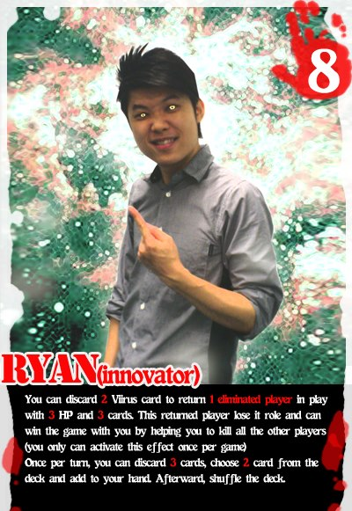
Most
Exception!!
Powerful!!
Great
Win
Effect
!!
Faster
?!

Slide 22
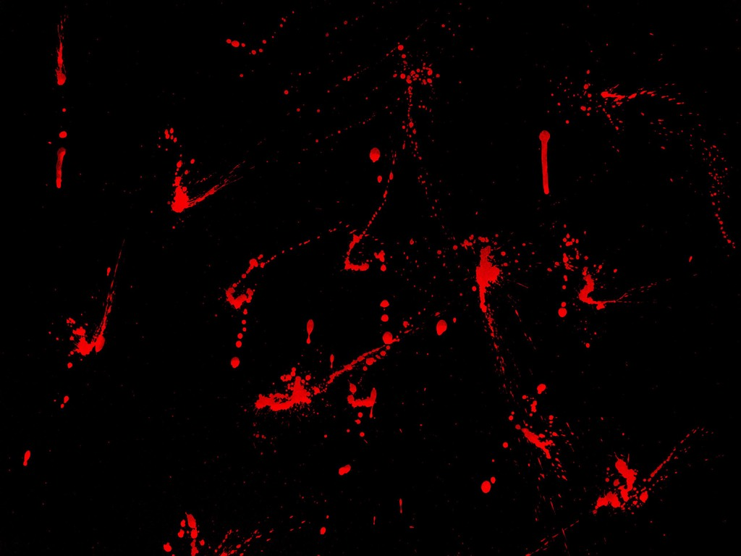
Comparison

Slide 23
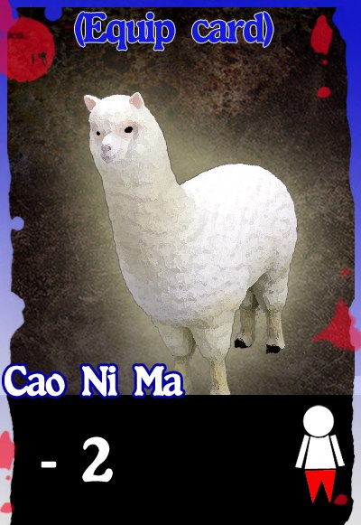
Cope with the new story
Changed the names of the cards
Let players feel the difference of the game
Some funny names to make the game more interesting
e.g. cao ni ma(alpaca)

Slide 24
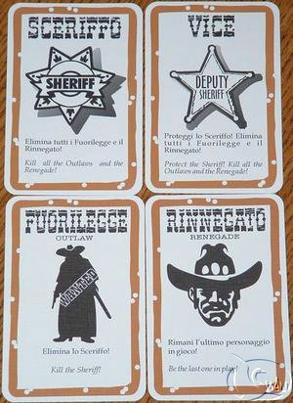
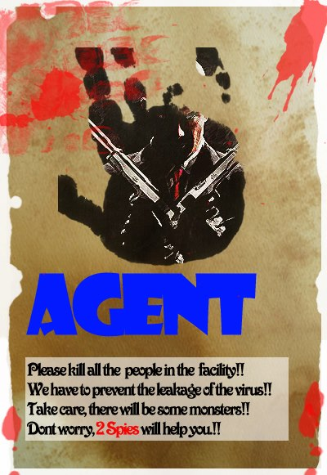



Roles

Slide 25
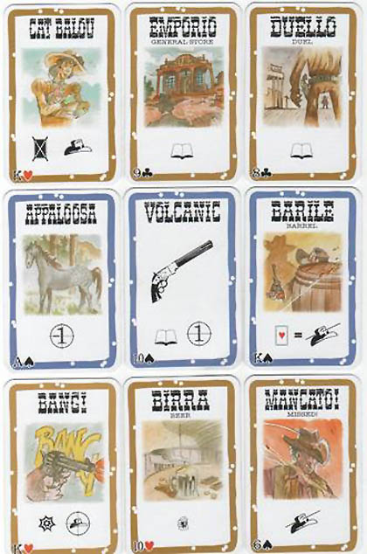

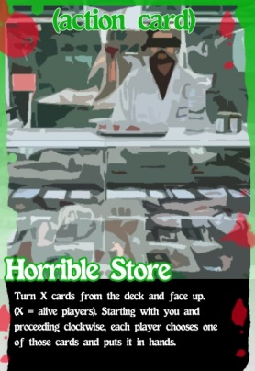
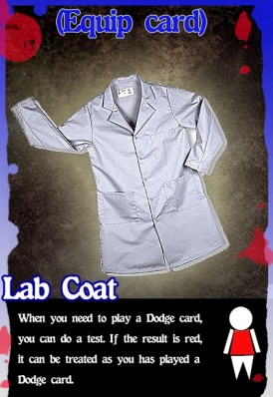
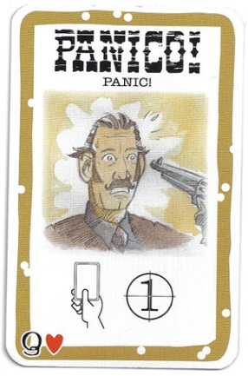
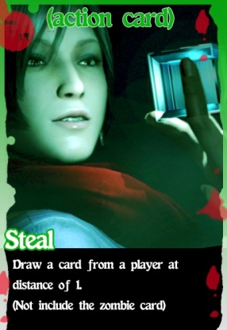
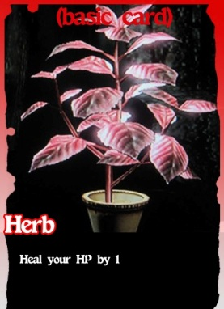


Cards

Slide 26



Slide 27



Slide 28



Slide 29


Slide 30

New Experience

Slide 31




New Excitement
Fans
Maybe a little bit Astonishing….
Films
Comics
Games

Slide 32




Zombie Cards (6 types)

Slide 33



New Flexibility

Slide 34
Virus Cards (3 types)

Slide 35


Basic Cards (5 types)
Attack!!!

Slide 36










Equip Cards (Hands)

Slide 37



Equip Cards (Others I)

Slide 38


New Pleasure
Only Horrible?
NO WAY!

Slide 39
Source
http://4.bp.blogspot.com/_NW50FBr1aeg/TQss6sXAiuI/AAAAAAAACII/VdcJ4bGhvqY/s1600/the%2Blast%2Bsurvivor%2Bfrontsmall.jpg
http://images4.alphacoders.com/548/54846.jpg
http://www.rockstargames.com/agent/images/agent.jpg
http://vandosersengrapefinancier.blog.com/files/2010/06/Key.jpg
http://2.bp.blogspot.com/_nIWiKIscZJY/TQbDHxsKFYI/AAAAAAAACz0/Of1fgNu_FCg/s1600/zombies.jpg

Slide 40

END

Slide 41

Q & A

Slide 42


